Slide 1
Investigating P2P Data Leakage at Beat Step
K.ANUGNA SAI
AP24122050013

Slide 2
CASE INTRODUCTION
Beat Step reported a data breach involving two audio files:
Contraband.mp3 (copyrighted)
Sample-1.mp3 (confidential)
Objective: Identify how the files were leaked and who was responsible.
Two suspects: Kamryn Allen and Willis Gibbs

Slide 3
Forensic Methodology
Acquisition: Disk imaging, hash verification.
Recovery: Torrent files, email artifacts, browser history.
Analysis: Timeline creation, file metadata, MFT parsing.
Presentation: Structured report and conclusions

Slide 4
Tools
md5deep, sha1deep – hash verification
Regripper – registry analysis
icat, fls – file recovery
sqlite3 – browser analysis
Mutt – email investigation
analyzeMFT, strings, hexedit, Exiftool – metadata and signatures

Slide 5
Forensic Process Overview with Key Evidence
Acquisition Phase:Disk_Image_ID-20210327.001
Verified with md5deep / sha1deep
Artifacts: Registry hives, torrent files, email, browser data
Recovery Phase:Found: .mp3 and .torrent files
Browser history, email (Thunderbird), torrent logs
Analysis Phase:
Hash match confirmed authenticity
MFT timeline showed file activity
Registry and logs linked file usage
Presentation Phase:Documented timeline and findings
Chain of custody preserved

Slide 6
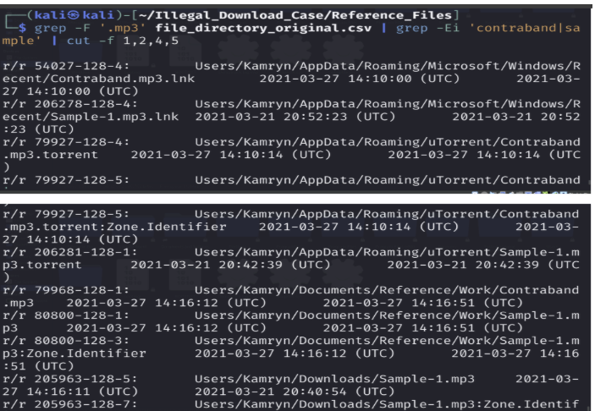
Crucial Finding 1 – File Possession
Files & .torrents found on Kamryn’s system
File hashes matched Beat Step’s originals
Link files and paths confirmed presence
Unauthorized possession of confidential data

Slide 7
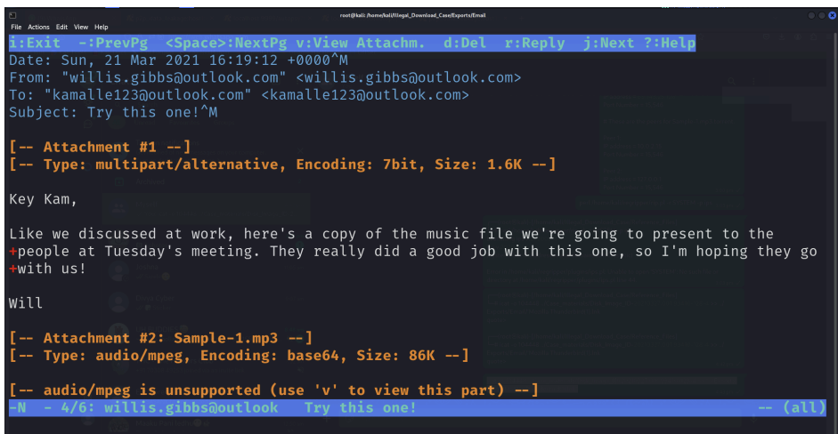
Crucial Finding 2 – Email Communication
Emails from Willis: Sample-1.mp3 & Contraband.torrent
Kamryn replied and forwarded to outside contacts
Mentions of “leaker community” in email
Suggests deliberate sharing

Slide 8
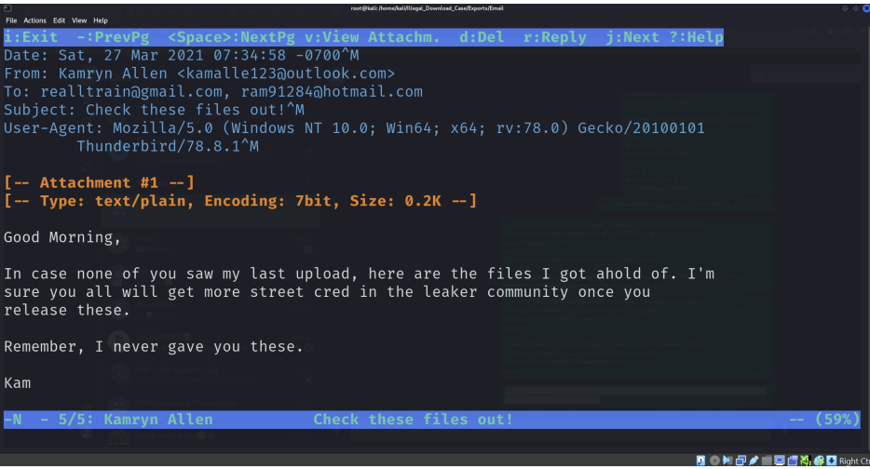
Crucial Finding 3 – File Distribution
Kamryn emailed both files externally
Sample-1.mp3 was seeded by her (sole seeder)
Contraband.torrent created with qBittorrent (not installed on her system)
Indicates file was received, not created.

Slide 9
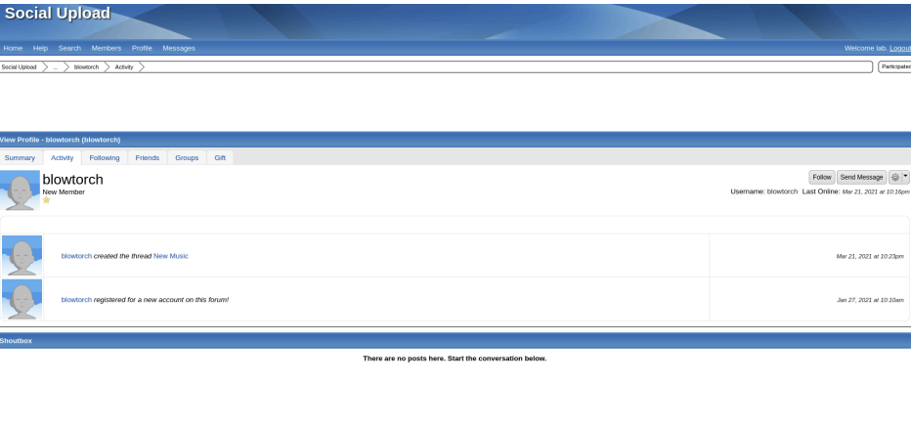
Crucial Finding 4 – Web Activity
Kamryn browsed tracker lists on GitHub
Logged into "Social Upload" file-sharing forum
Created thread: "New Music"
Activity matches file distribution times

Slide 10
Timeline of Events
March 10 – Installed uTorrent, Thunderbird
March 21 – Received Sample-1 from Willis
March 27 – Received Contraband.torrent and emailed both files externally
All actions confirmed by MFT & logs

Slide 11
Conclusion
Kamryn possessed and distributed sensitive files
Created and seeded Sample-1.torrent
Contraband.torrent linked to Willis (external origin)
Strong evidence of coordinated internal leak

Slide 12
Recommendations
Restrict use of email clients and torrent tools
Implement network traffic and log monitoring
Conduct employee awareness and security training
Perform regular forensic audits
Enhance access control and policy enforcement

